Slide 1
Section 6.2 Trigonometric Problems
© Copyright all rights reserved to Homework depot: www.BCMath.ca

Slide 2
Q: Suppose Angles “A” and “B” add to 90ᴼ, then which of the following will be true? (Take 1 minute)
a) Sin A = Cos A
b) Sin A = Cos B
c) Sin B = Cos A
d) Sin B = Cos B
e) Sin A + Cos B = 0
Both “B” and “C” are true

Slide 3
(Take 2 min)
Add the two equations!
Note: You don’t always need to use trig. Pythagorean Thm also very useful

Slide 4
Ex: A hill 250m hill creates an angle of inclination of 10 degrees. What is the slope of the hill?
Find the Opposite & Adjacent
Divde Rise over Run to Find the Slope
NOW, instead, take “Tan” of the angle!!
What do you notice??
Tan the angle of Inclination to get the slope

Slide 5
I) Problems Involving Right Triangles
When solving problems involving a combination of right triangles
Separate the diagram into different RT’s
Find out what you need from each triangle
Solve each RT separately, but only for sides/angles that you need
Ex#1) Given that AD =17cm, ∠ABD =25°, ∠ACD =40°, find BC
Gather Information:
2 Right Triangles
Total Distance for BC:
To find BC, you need both “x” & “y”

Slide 6
Practice: Given that AB =17cm, ∠BAD =39°, & BC =40, find ∠BCD
Gather Information

Slide 7
Q: In the diagram below, ABCD is a rectangle. Find the length of DQ:
Answer “B”
Just Kidding, Answer “A”

Slide 8
EX#3) A SNIPER IS STANDING AT THE TOP OF A BUILDING. HE’S AIMS HIS GUN AT A TOWER THAT’S 70METERS AWAY. IF HE AIMS HIS GUN TO THE TOP OF THE TOWER, THE ANGLES OF ELEVATION IS 55 DEGREES. IF HE AIMS HIS GUN TO THE BOTTOM OF THE TOWER, THE ANGLE OF DEPRESSION IS 35 DEGREES. HOW HIGH IS THE TOWER?
Gather Information
2 Right Triangles

Slide 9
EX#4) TOM IS STANDING IN BETWEEN TWO TREES THAT IS 120METERS APART. THE ANGLE OF ELEVATION TO THE TOP OF TREE A AND TREE B IS 47 ° AND 33 ° RESPECTIVELY. TREE A IS 25M TALL. (NOTE: TOM DOESN’T KNOW HOW FAR HE IS FROM EITHER TREE. HE ONLY KNOWS THAT THEY ARE 120METERS APART). HOW TALL IS TREE B?
Gather Information
2 Right Triangles

Slide 10
Challenge: Given that 2 squares of length 15cm are placed next to each other. What is the measure of
Find each angle separately and subtract them
Isosceles Triangle!!

Slide 11
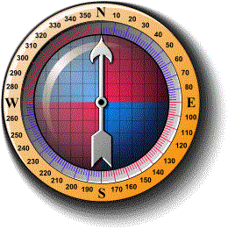
II) Reading Bearings
A bearing is an angle measured in degrees in a clockwise direction from due North
Used by sailors for directions
EAST
SOUTH
WEST
NORTH EAST

Slide 12
Ex: A ship leaves Genoa on a bearing of 155 degrees. It travels on the path until Cagliari is due West and turns towards Cagliari. If the distance between Genoa and Cagliari is 579km, how far did the ship travel?
Find the Length of the Hypotenuse
and Opposite side

Slide 13
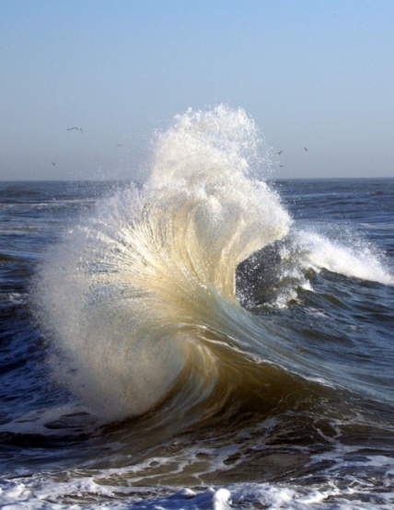
Practice: A group of Pirates leave Batumi on a bearing 280. To avoid a hurricane near the coast of Turkey, they stay on the path until Istanbul is due South. Afterwards, they sail 200km south and reached Istanbul. How far did they sail?
The total distance travelled will be the sum of the “OPP” and the “HYP”
Turkey

Slide 14
Q: Suppose Angles “A” and “B” add to 180ᴼ, then which of the following will be true? (Take 2 minutes)
a) Sin A = Cos B
b) Sin A = sin B
c) cos A = cos B
d) Sin B = Cos A
e) Sin A + Cos B = 0
Answer “B”

